Slide 1
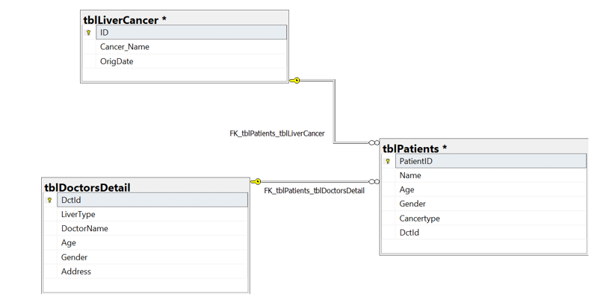
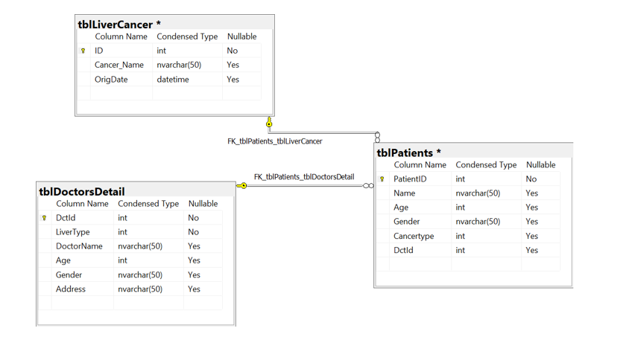
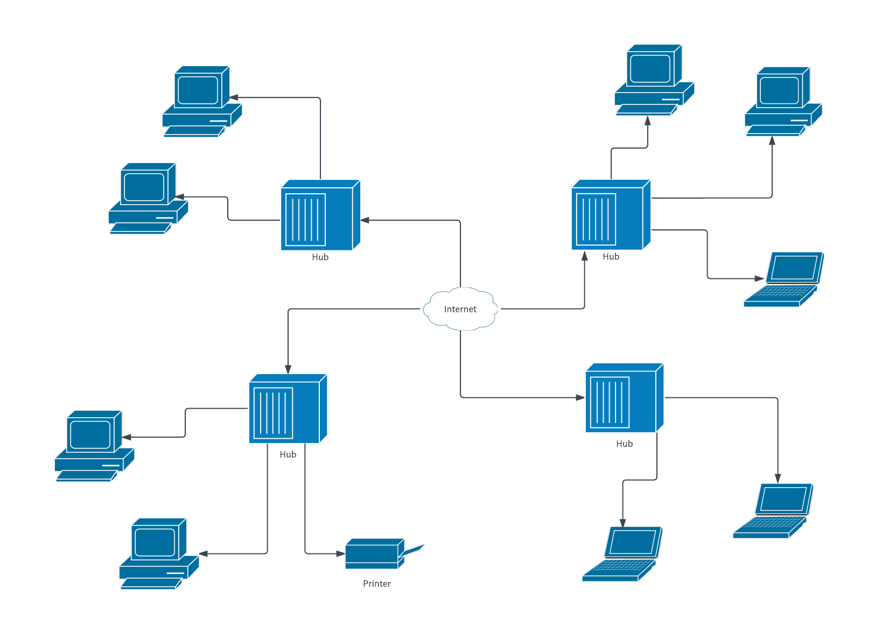
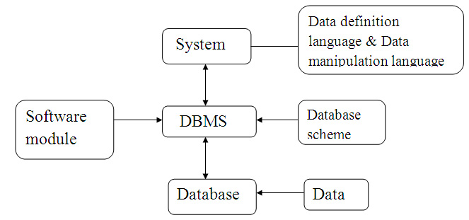
Liver Cancer Risk Assessment and the Monitoring
Cancer is the abnormal cell uncontrolled growth in the body that develops when the control mechanism in the body stops functioning in the person. So, in this case, abnormal cells start growing inside the body, and old cells in the body do not die and they start growing out of control which leads to the death of the person. Such cells might form a tissue mass that is called a tumor. The selected topic in the research for what the database system is required to develop is the Liver Cancer Risk Assessment and the Monitoring. The database system would help to maintain the data on liver cancer in the body and the risk probability of this cancer. This database development is aimed at monitoring cancer and managing treatments effectively.
When the data of the system is gathered or the attributes of the entities are collected then there is also a need to define the type of the data that gives the form of storing the data in the database. For example, if the Id is required to be captured in the database, then there is a need to define the data type such as integer form. This is called relational schema that creates tables for the data that make it easy to define all the data into the database in its real form whether integer or variable, dates or time. This is how the instructions are provided for the real outputs. This is required to perform and the above-shown diagram is presenting all the data with the tables that are containing its types effectively
This is an infrastructure model that is presenting the system with data definition, database scheme, data, database, DBMS, and the software modules.
While creating a database, all these are required effectively where the data in the database system can be recorded effectively. This is how the data is managed and results are achieved better than expected
This is called a database networking model where the data hub, print, er, and the several systems are connected to the internet. This is how the data is processed and stored in the system to get seethe security of the data and to get management of data effectively.
References
Dasgupta, P., Henshaw, C., Youlden, D. R., Clark, P. J., Aitken, J. F., & Baade, P. D. (2020). Global trends in incidence rates of primary adult liver cancers: A systematic review and meta-analysis. Frontiers in oncology, 10, 171.
Liu, M., Yan, Q., Sun, Y., Nam, Y., Hu, L., Loong, J. H., ... & Guan, X. Y. (2020). A hepatocyte differentiation model reveals two subtypes of liver cancer with different oncofetal properties and therapeutic targets. Proceedings of the National Academy of Sciences, 117(11), 6103-6113.

